Slide 1
Roman COINS, PrIVATE COLLECTION OF MARIA S. MARSILIO
Dr. Maria S. Marsilio
Saint Joseph’s University

Slide 2
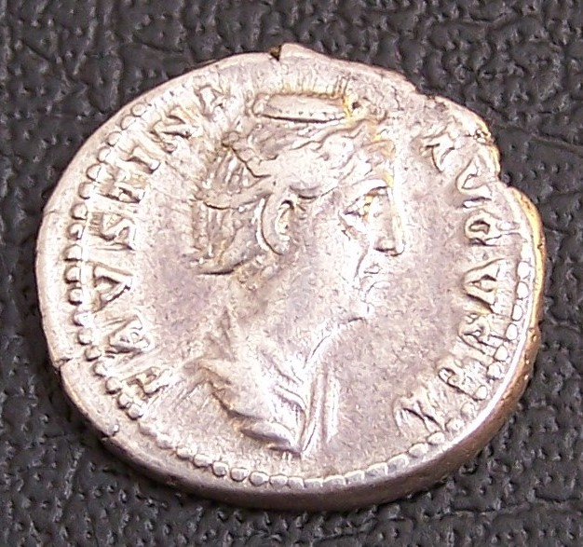
Faustina Sr. AR Denarius, AD 141. Lifetime issue, Obverse
Notes:
Imperial Rome, Faustina Sr., the wife of the emperor Antoninus Pius. Augusta, AD 138-141. AR Denarius, struck AD 141 before her death. Rome. 18.5mm. 3.10g. FAUSTINA AUGUSTA, her draped bust right. Reverse: IVNONI REGINAE, Juno standing left, holding a patera and a scepter, a peacock at her feet. RIC 338; BMCRE 136; RSC 215. Coins struck during her short time as Augusta are much rarer than the many types issued after her death in AD 141.

Slide 3
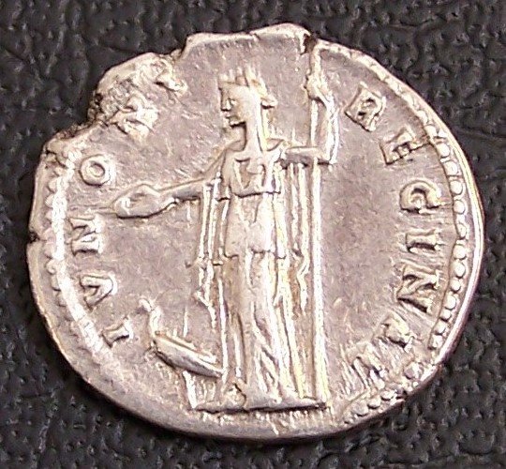
Faustina Sr. AR Denarius, AD 141. Lifetime issue, Reverse
Notes:
Imperial Rome, Faustina Sr., the wife of the emperor Antoninus Pius. Augusta, AD 138-141. AR Denarius, struck AD 141 before her death. Rome. 18.5mm. 3.10g. FAUSTINA AUGUSTA, her draped bust right. Reverse: IVNONI REGINAE, Juno standing left, holding a patera and a scepter, a peacock at her feet. RIC 338; BMCRE 136; RSC 215. Coins struck during her short time as Augusta are much rarer than the many types issued after her death in AD 141.

Slide 4
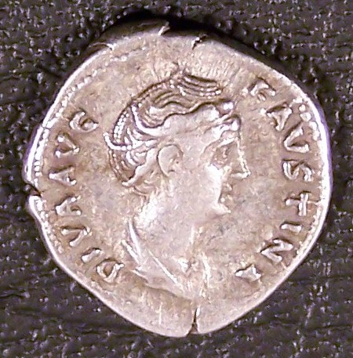
Faustina Sr. AR Denarius, Obverse
Notes:
Imperial Rome, Faustina Sr., the wife of the emperor Antoninus Pius. Augusta, AD 138-141. AR Denarius, struck AD 147-161 in her memory. Rome. 3.01g. DIVA FAUSTINA, her draped bust right. Reverse: CONCORDIAE, Antoninus Pius and Faustina clasping hands. BMC 298. C. 159. Hill 468. RIC 381b. Strack 422. VF. A scarcer type.

Slide 5
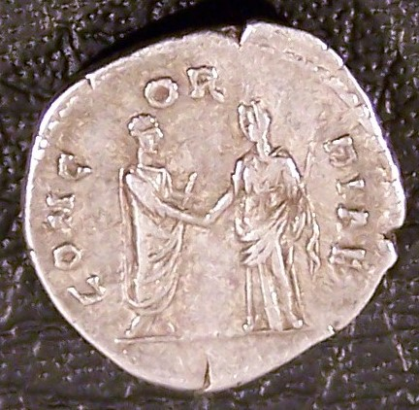
Faustina Sr. AR Denarius, Reverse
Notes:
Imperial Rome, Faustina Sr., the wife of the emperor Antoninus Pius. Augusta, AD 138-141. AR Denarius, struck AD 147-161 in her memory. Rome. 3.01g. DIVA FAUSTINA, her draped bust right. Reverse: CONCORDIAE, Antoninus Pius and Faustina clasping hands. BMC 298. C. 159. Hill 468. RIC 381b. Strack 422. VF. A scarcer type.

Slide 6
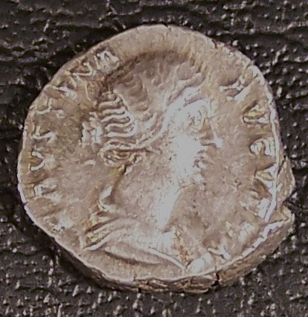
Faustina Jr. AR Denarius, AD 157-161, Obverse
Notes:
Imperial Rome, Faustina Jr., the wife of Marcus Aurelius. Augusta, AD 147-175/6. AR Denarius, AD 157-161. Rome. 3.70g. FAVSTINA AVGVSTA, her draped bust right. Reverse: AVGVSTI PII FIL, Venus standing left, holding Victory and resting on a shield. RIC 495a; BMCRE 167, 1099. VF.

Slide 7
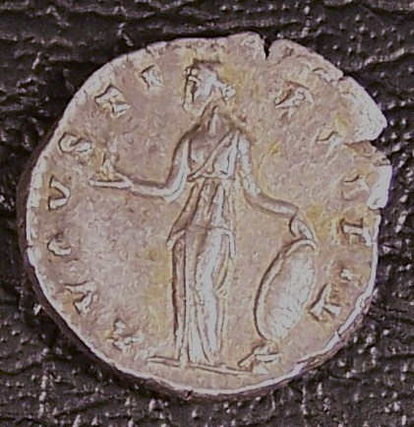
Faustina Jr. AR Denarius, AD 157-161, Reverse
Notes:
Imperial Rome, Faustina Jr., the wife of Marcus Aurelius. Augusta, AD 147-175/6. AR Denarius, AD 157-161. Rome. 3.70g. FAVSTINA AVGVSTA, her draped bust right. Reverse: AVGVSTI PII FIL, Venus standing left, holding Victory and resting on a shield. RIC 495a; BMCRE 167, 1099. VF.

Slide 8
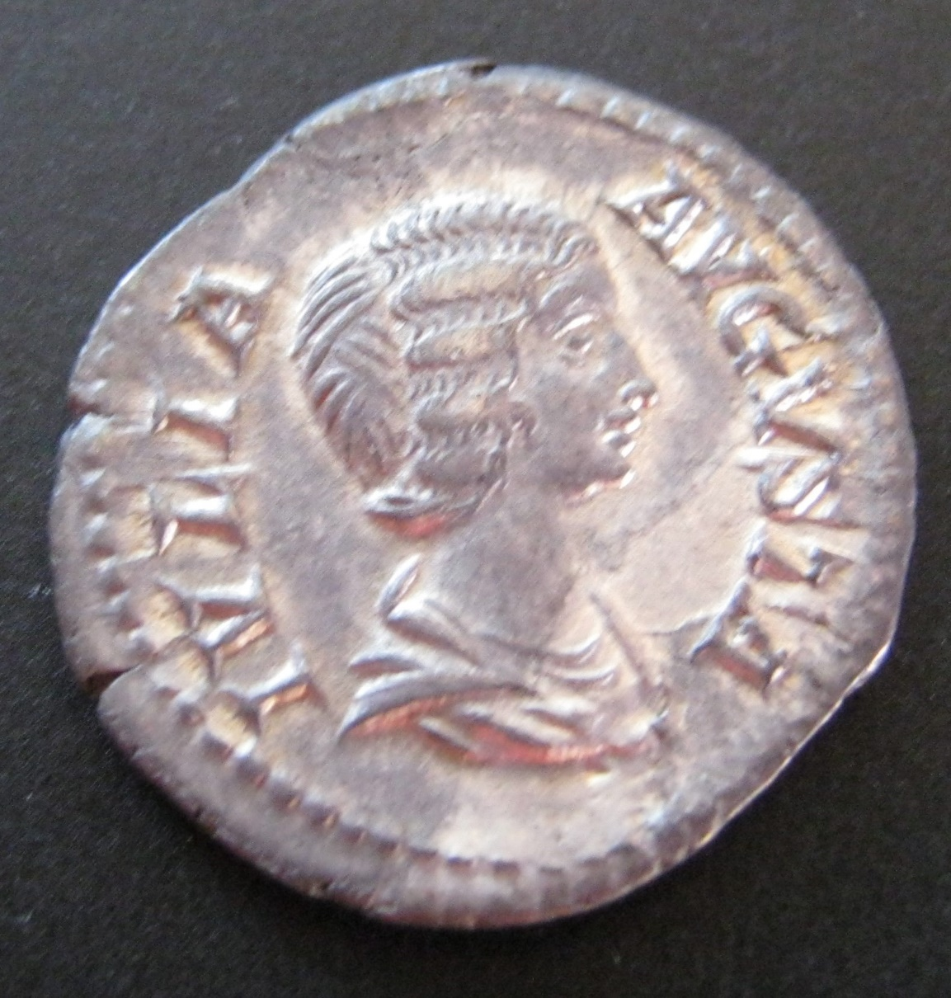
Julia Domna, AR Denarius, Obverse
Notes:
Imperial Rome, Julia Domna, the wife of Septimius Severus. Augusta AD 193-217. AR Denarius, AD 198. Rome. 2.00g. 19mm. IVLIA AVGVSTA, her draped bust right. Reverse: MATER DEVM, Kybele seated left, holding a branch and scepter, lions beneath her seat. RIC 564; BMCRE 163.51; RSC 123. VF.

Slide 9
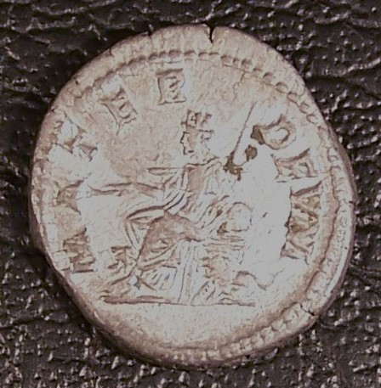
Julia Domna, AR Denarius, Reverse
Notes:
Imperial Rome, Julia Domna, the wife of Septimius Severus. Augusta AD 193-217. AR Denarius, AD 198. Rome. 2.00g. 19mm. IVLIA AVGVSTA, her draped bust right. Reverse: MATER DEVM, Kybele seated left, holding a branch and scepter, lions beneath her seat. RIC 564; BMCRE 163.51; RSC 123. VF.

